Slide 1

Travel and Expense

Slide 2
Travel and Expense
The Department of Finance has partnered with the Office of Information Technology(OIT) to automate the current Travel and Expense Policy for the City Colleges of Chicago(CCC). Using the PeopleSoft Travel and Expense module, Finance and OIT will deliver a technical solution integrated with data from HR, Payroll and Accounts Payable. The end result will be a “Policy Driven”, fully automated process that will provide transparency, expedite payments and reduce manual processes for CCC Employees, Management and Finance Staff.
Notes:
Here’s our Agenda.

Slide 3
Focus on 3 Areas of Travel and Expense
Travel\Expense Authorization
Cash Advances
Travel\Expense Reimbursement
SGA &
ATHLETIC
ONLY
Travel and Expense Software will automate each area above
Notes:
Cash advances are for coaches and chaperones only?

Slide 4
AP Prepaid Travel/Cash Advance Authorization Workflow Examples
Travel Related Prepaid Expenses
Create AP Prepaid Voucher
Payment is processed and disbursed to Vendor
Vendor receives payment
TA – Prepaid Registration
CA is enter by the Employee or Student Services Dept. /Designee
Employee receives payment
AP notifies Employee by email to Create a Cash Advance Voucher
AP Prepay Auditors Final Review & Approval
Cash Advance processed and disbursed to Employee
CA is routed through Approval Workflow
(TA) Employee Cash Advance

Slide 5
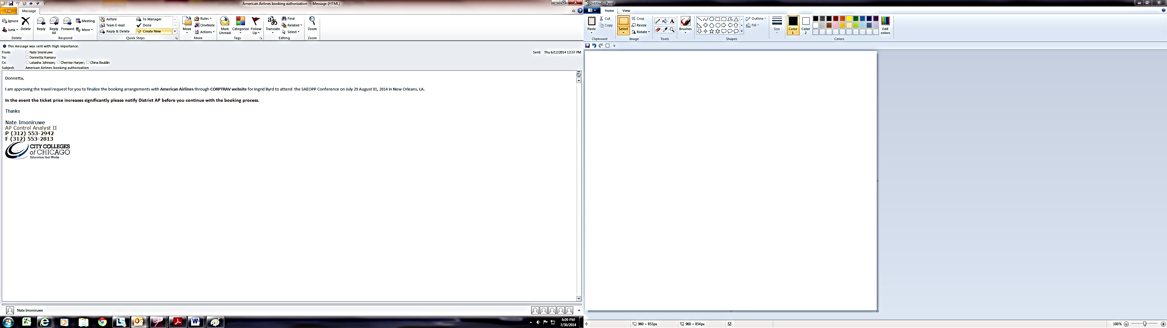
AP EMAIL AUTHORIZATION TO FINALIZE BOOKING

Slide 6
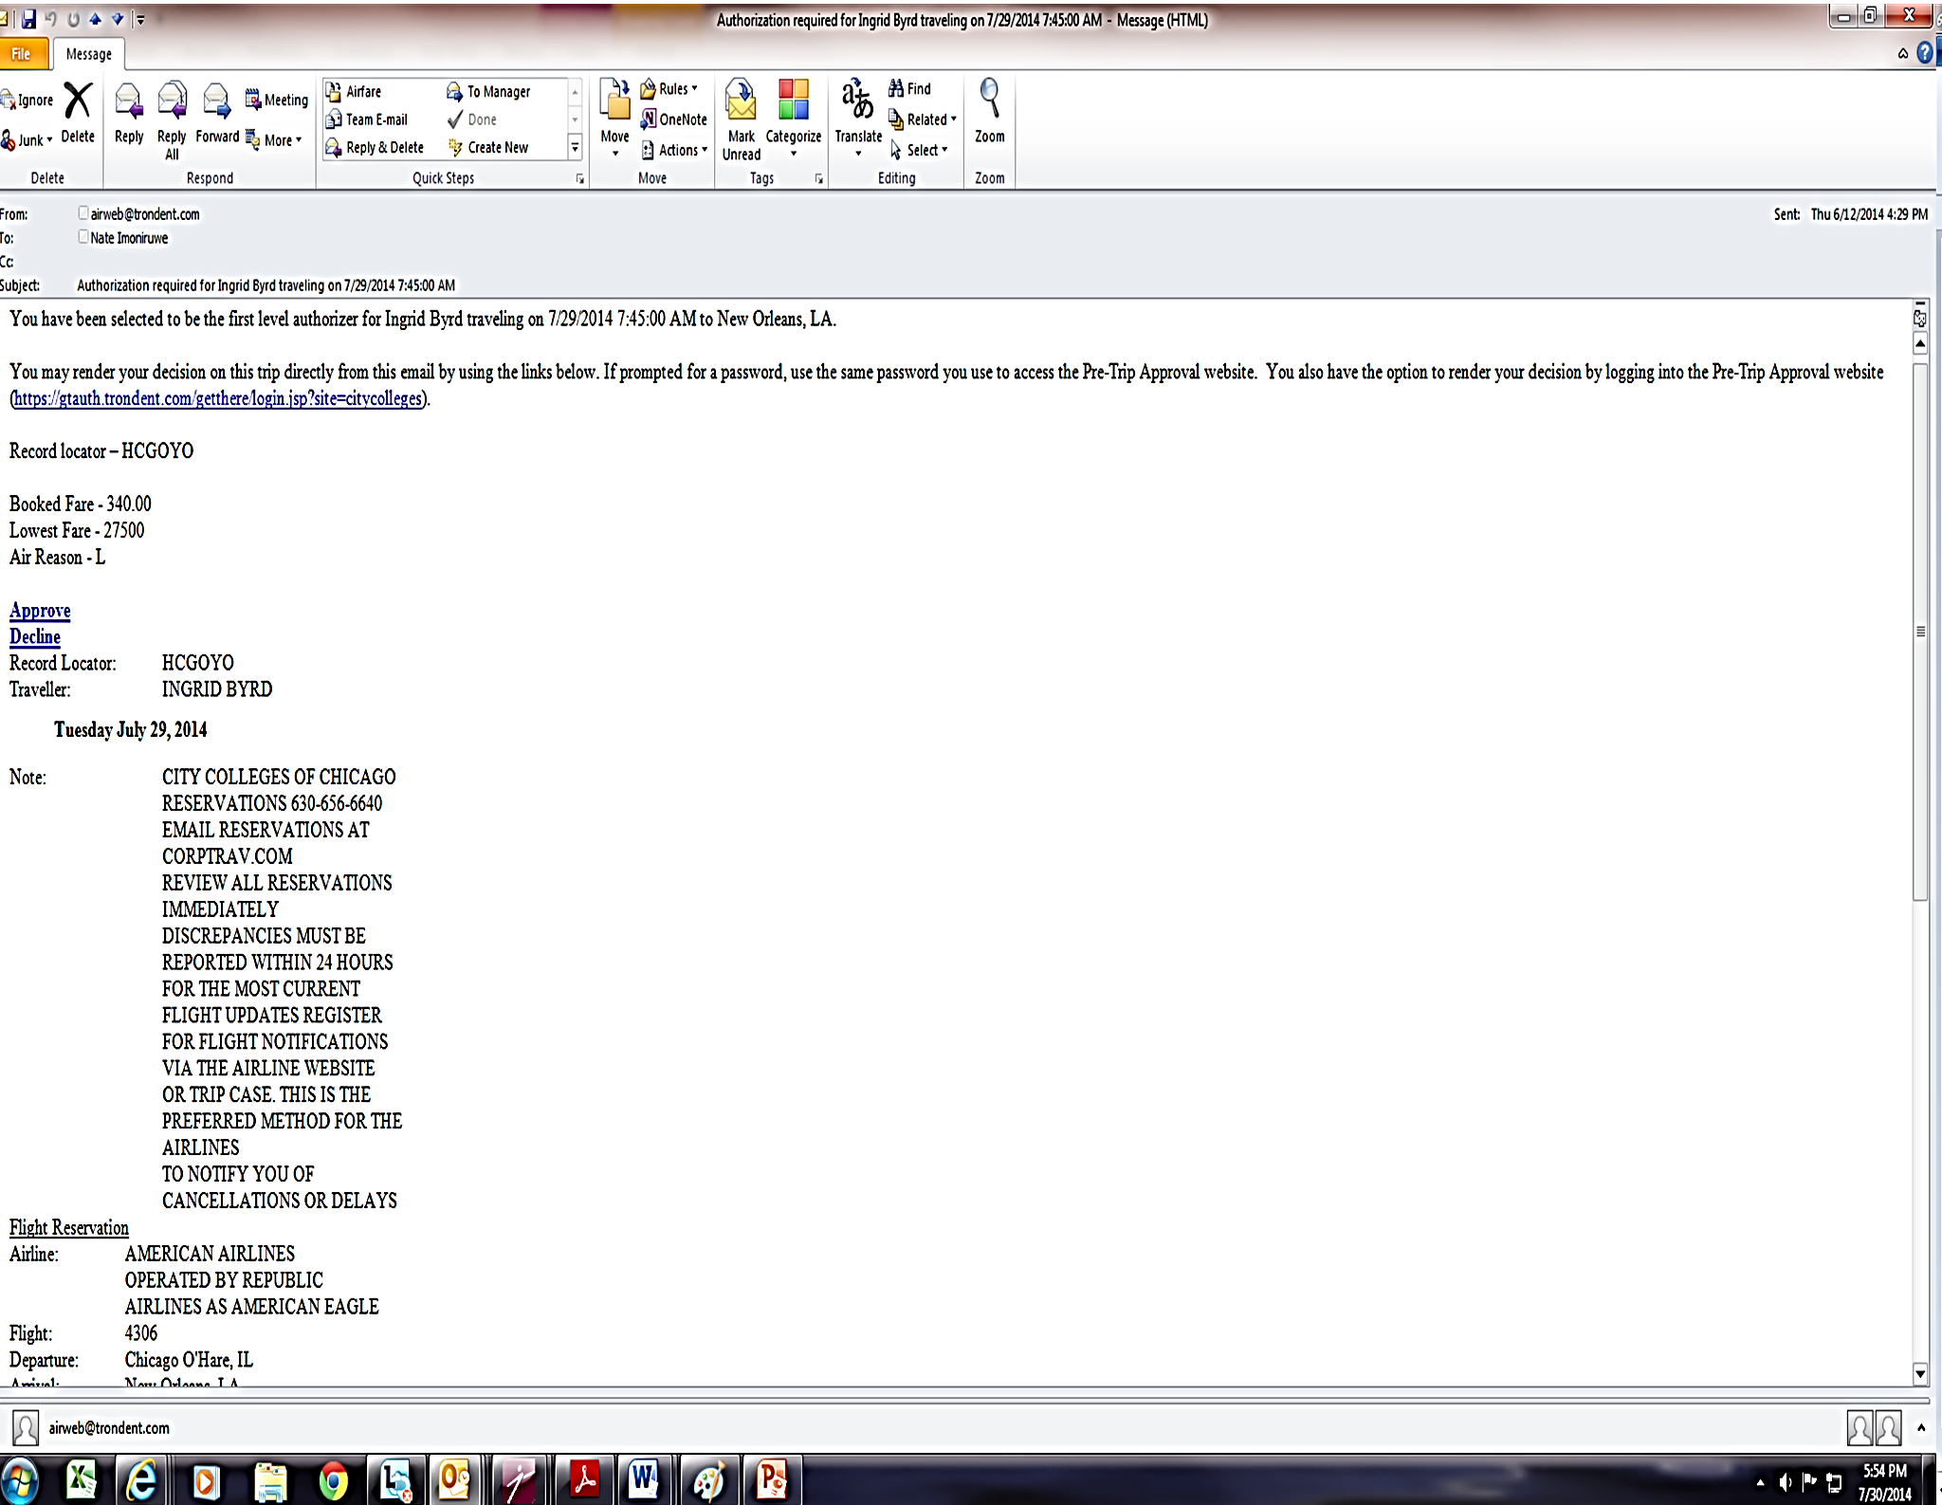
AP CORPTRAV EMAIL AUTHORIZATION REQUEST

Slide 7
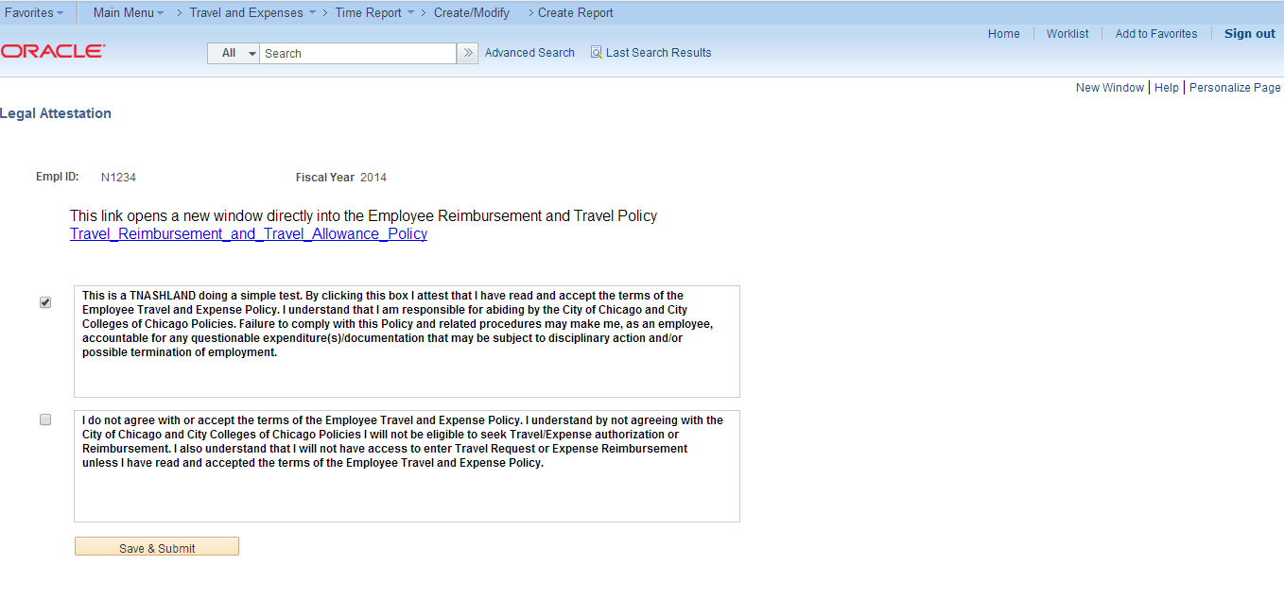
Annual Attestation Page

Slide 8
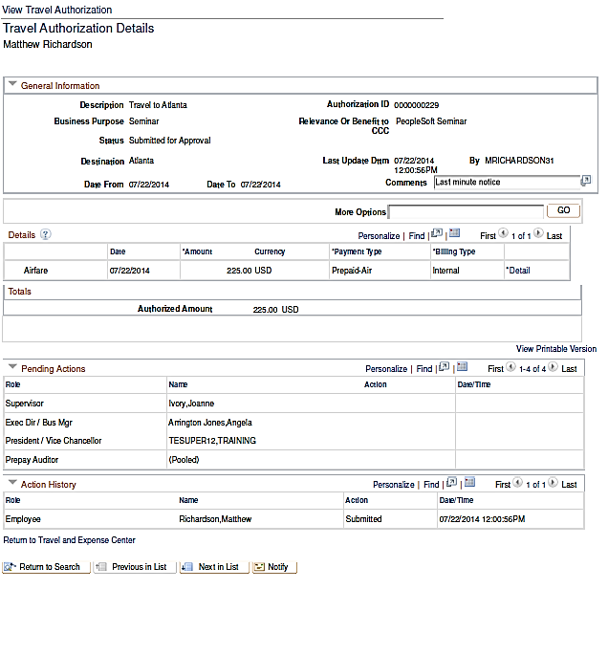

Slide 9
Travel Totals

Slide 10
Questions?
Q

Slide 11
Valid Budget for Training
Dept | Fund | Acct | Program | Class | PC Bus Unit | Project | GL Unit
0010002 | 00003 | ----- | 00086 | 00000 | CCCGO | 0000000 | CCCGO

